Slide 1
链路状态路由算法

Slide 2
Routing Algorithm classification
Global or decentralized information?
Global:
all routers have complete topology, link cost info
“link state” algorithms
Decentralized:
router knows physically-connected neighbors, link costs to neighbors
iterative process of computation, exchange of info with neighbors
“distance vector” algorithms
Static or dynamic?
Static:
routes change slowly over time
Dynamic:
routes change more quickly
periodic update
in response to link cost changes

Slide 3
A Link-State Routing Algorithm
Dijkstra’s algorithm
net topology, link costs known to all nodes
accomplished via “link state broadcast”
all nodes have same info
computes least cost paths from one node (‘source”) to all other nodes
gives forwarding table for that node
iterative: after k iterations, know least cost path to k dest.’s
Notation:
c(x,y): link cost from node x to y; = ∞ if not direct neighbors
D(v): current value of cost of path from source to dest. v
p(v): predecessor node along path from source to v
N': set of nodes whose least cost path definitively known

Slide 4
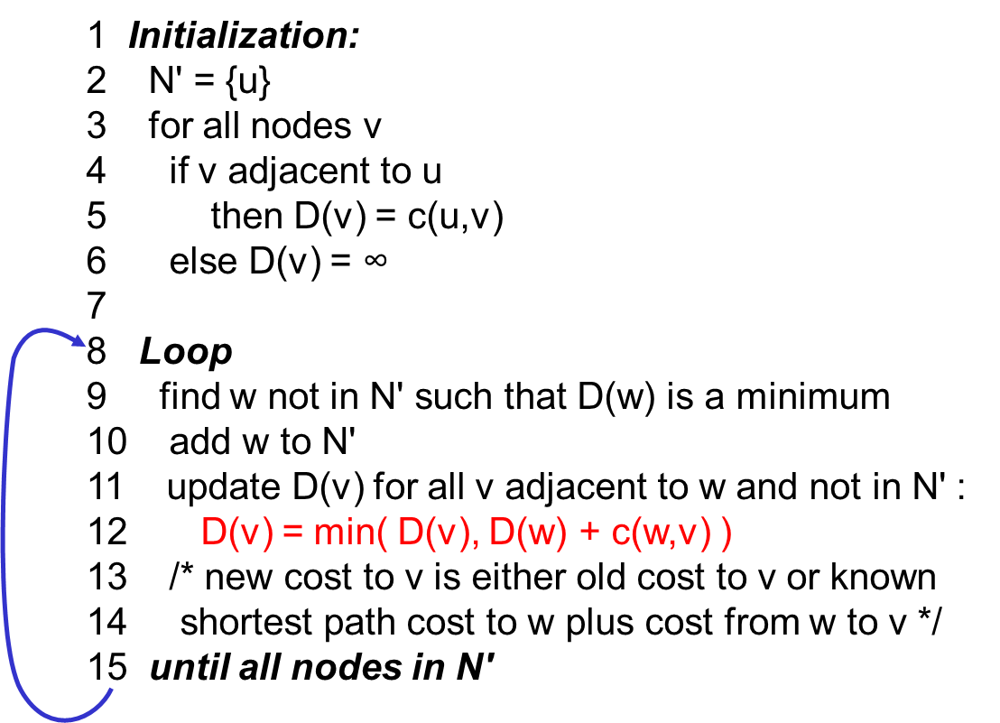
Dijsktra’s Algorithm

Slide 5
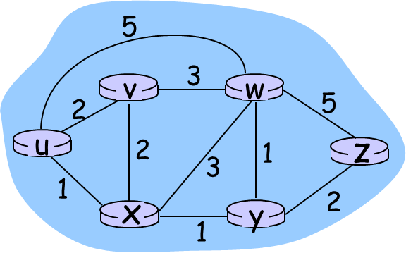
Dijkstra’s algorithm: example
Step
0
1
2
3
4
5
N'
u
ux
uxy
uxyv
uxyvw
uxyvwz
D(v),p(v)
2,u
2,u
2,u
D(w),p(w)
5,u
4,x
3,y
3,y
D(x),p(x)
1,u
D(y),p(y)
∞
2,x
D(z),p(z)
∞
∞
4,y
4,y
4,y

Slide 6
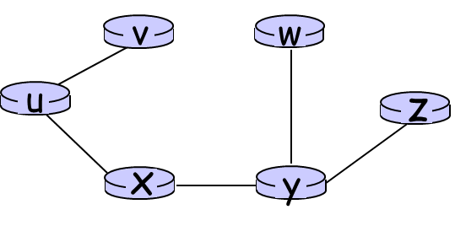
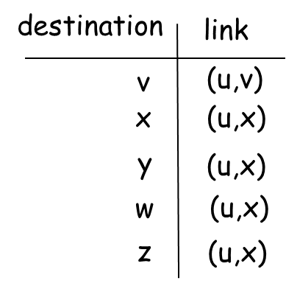
Dijkstra’s algorithm: example
Resulting shortest-path tree from u:
Resulting forwarding table in u:

Slide 7

Summary
Dijsktra’s Algorithm

